Slide 1

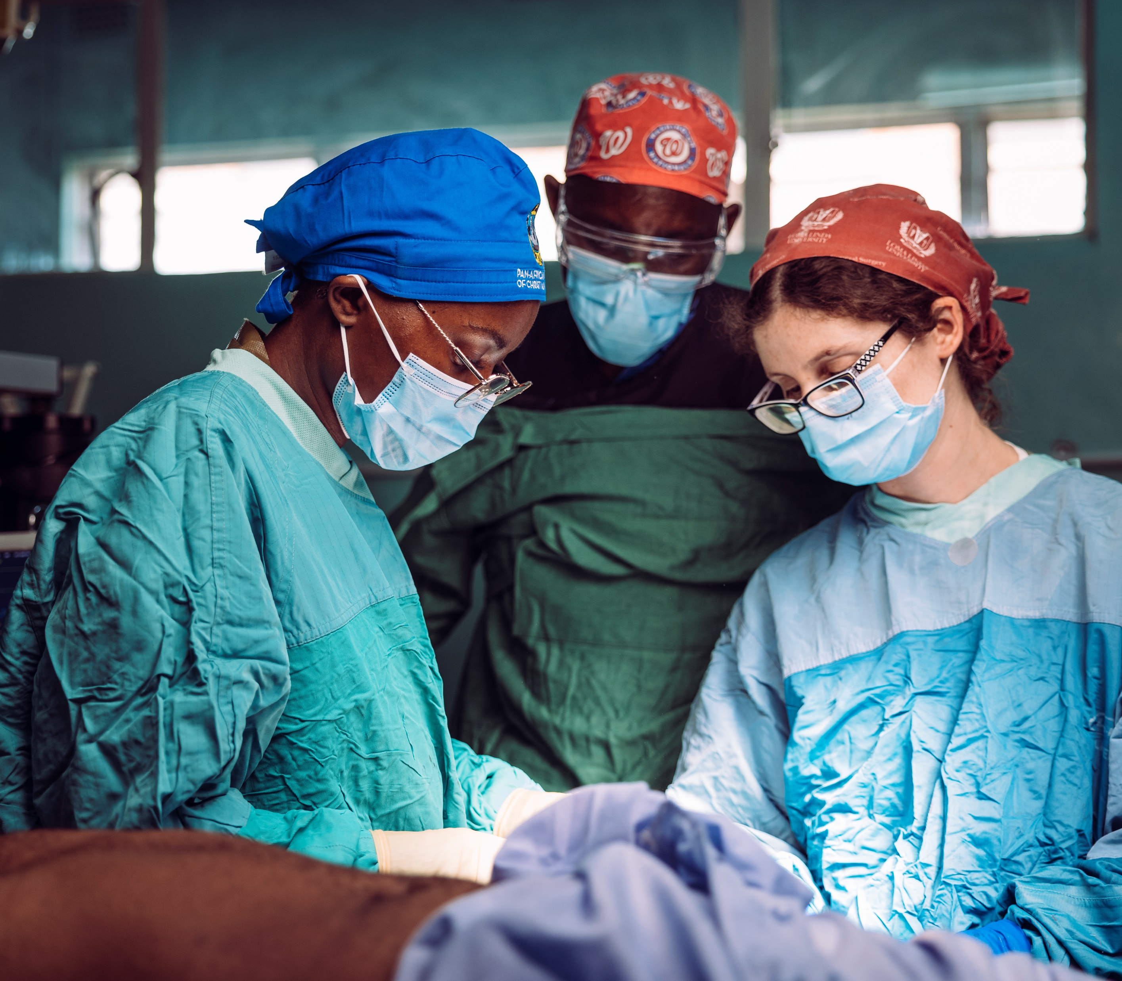
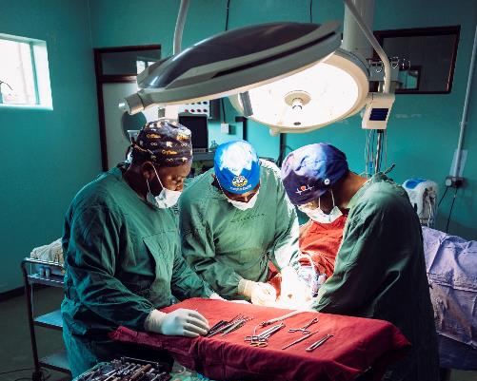
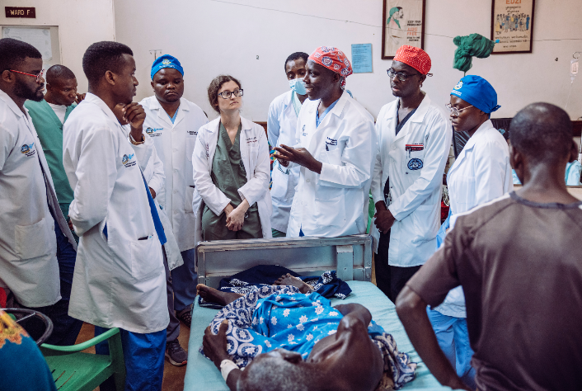

Pan-African Academy of Christian Surgeons
Reaching the Poor and Sick in Africa with Surgical, Anesthesia, and Obstetric Care AND the Hope of Jesus Christ

Slide 2
These were his instructions to them:
“The harvest is great,
but the workers are few.
So pray to the Lord
who is in charge of the harvest;
ask him to send more workers
into his fields.
Luke 10:2

Slide 3
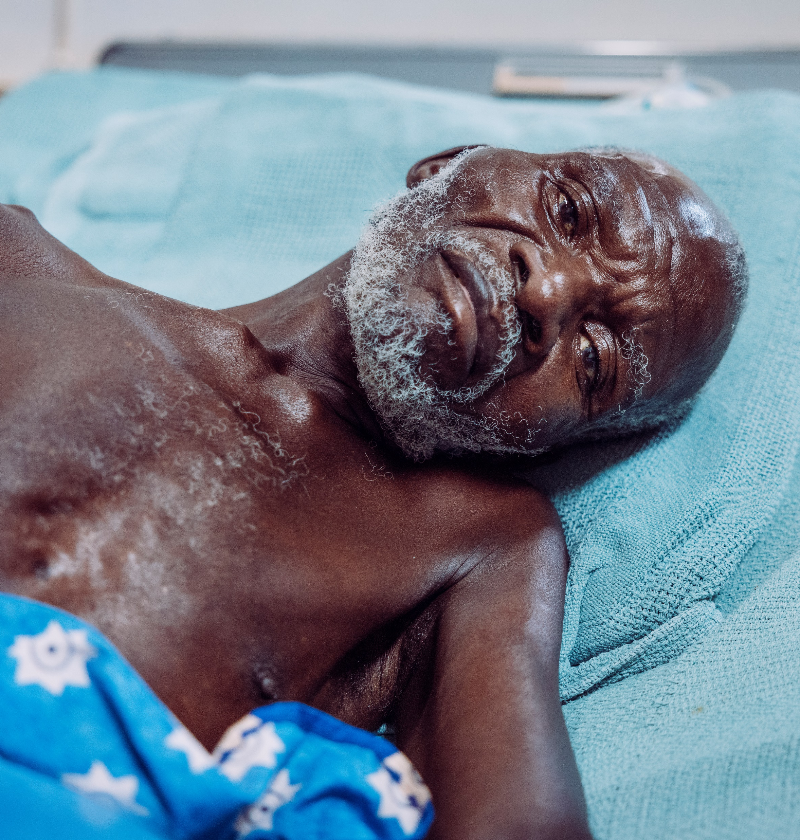
The Need in Africa
56 million
  People in sub-Saharan Africa Need Surgical Care

Slide 4

The Need in Africa
93%
Lack Access to Basic
Surgical, Anesthesia, and Obstetric Care that is
Safe, Timely, and Affordable

Slide 5
The World Health Organization recommends:
1 surgeon for every 20,000
Many places in Africa only have:
1 surgeon for every 250,000
In other places, the need is worse:
1 surgeon for every 2,500,000

Slide 6

New York
Malawi
Population: 19.6 Million
Population: 20.8 Million
General Surgeons: 2,017
General Surgeons: 42
*
**
Ratio – 1 surgeon : 9,700 people
Ratio – 1 surgeon : 495,104 people
World Health Organization Would Recommend at Least:
1,045
* https://www.aamc.org/media/34266/download
**globalsurgery.com

Slide 7
The Spiritual Need in Africa
418,869,000
Are Unreached with the Gospel
332,403,650
Greater than the Population of the Entire United States
https://joshuaproject.net/continents/AFR

Slide 8
The Spiritual Need in Africa
In the 11 countries with PAACS programs
94,294,000
Have Never Heard of Jesus Christ and His Sacrifice for Them
https://joshuaproject.net/continents/AFR

Slide 9
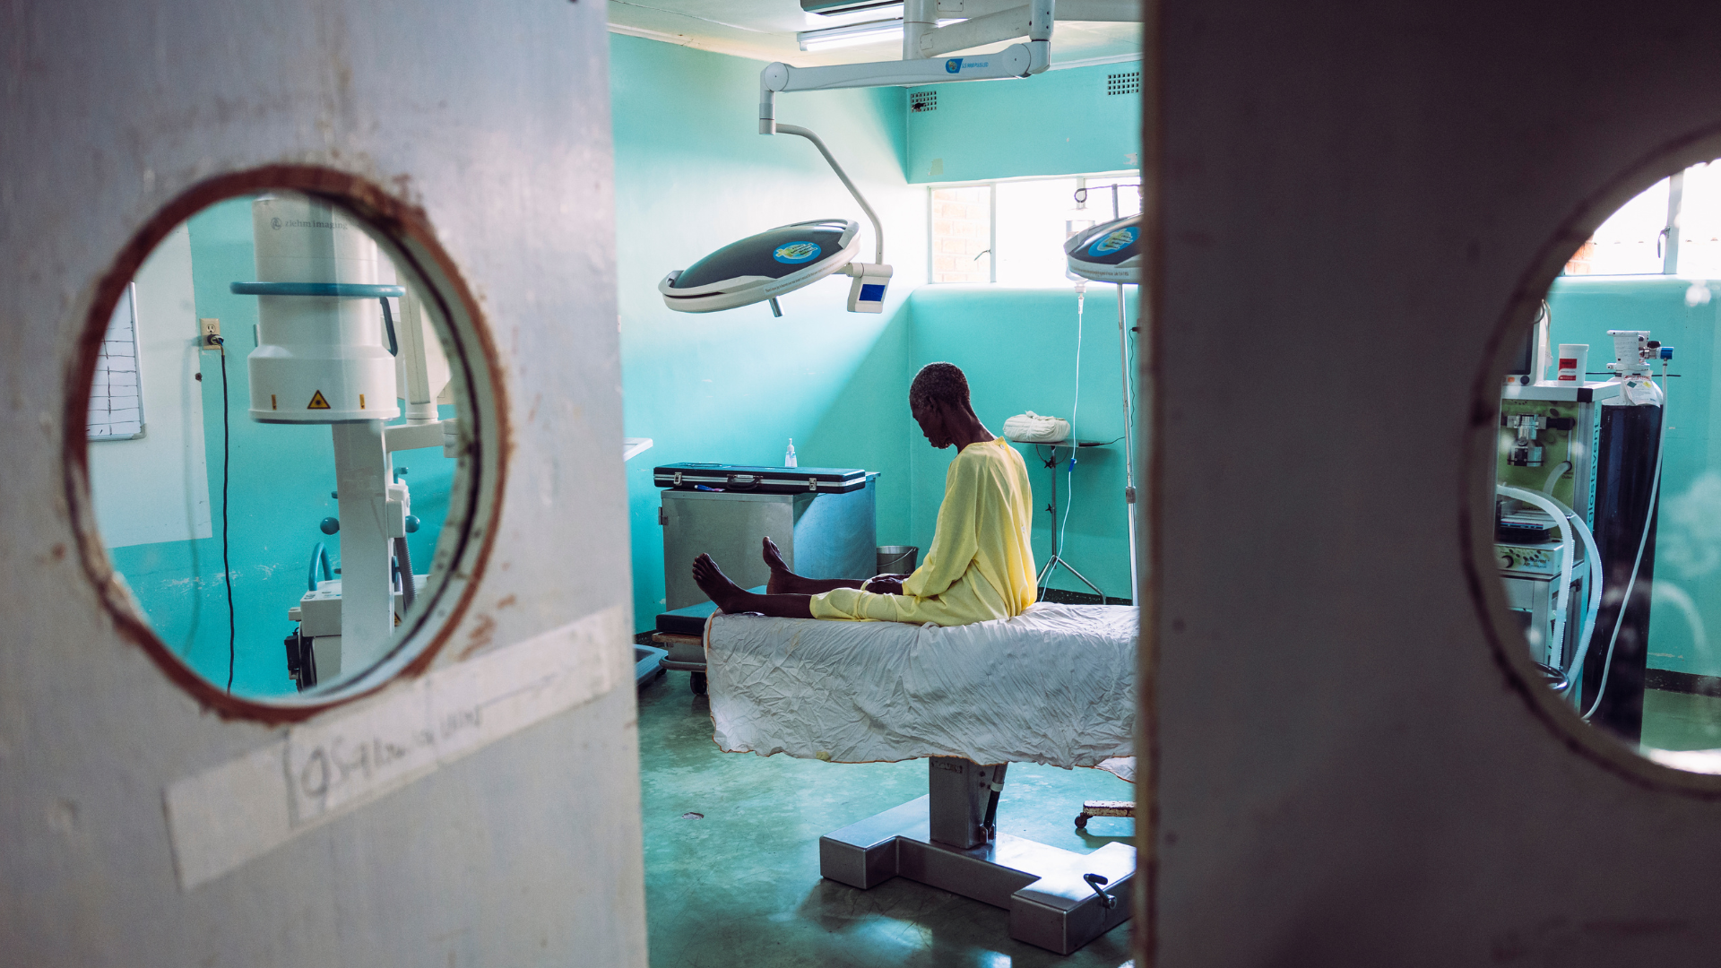
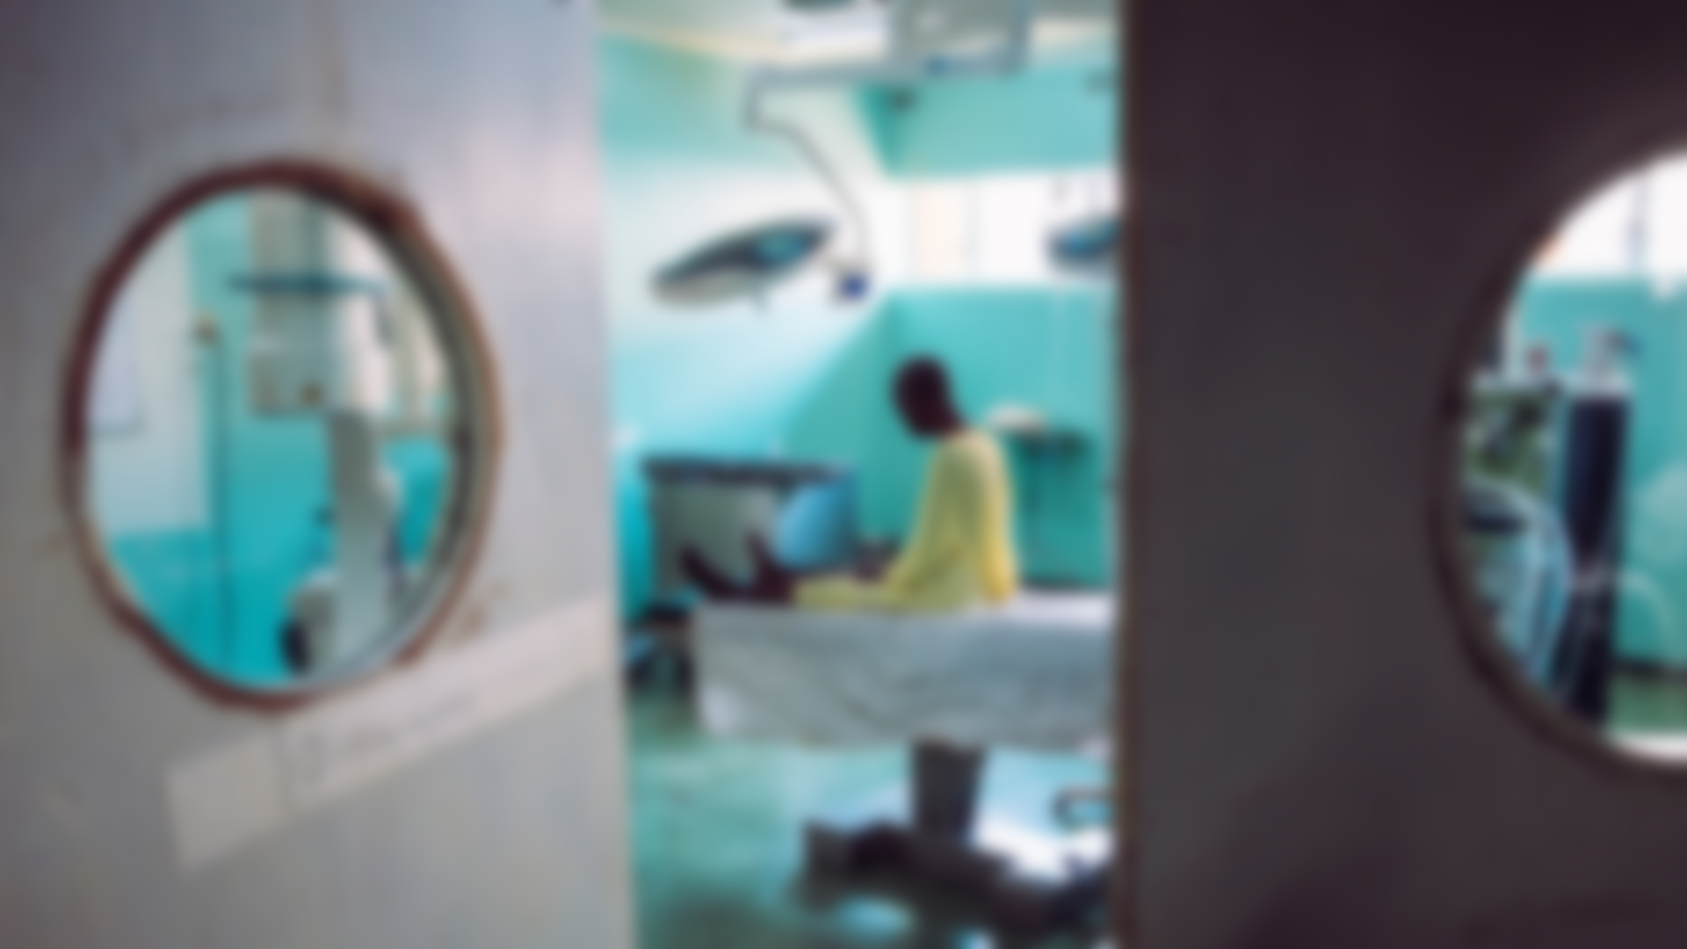
“Whom Shall I Send?
And Who Will Go For Us?”
Isaiah 6:8

Slide 10

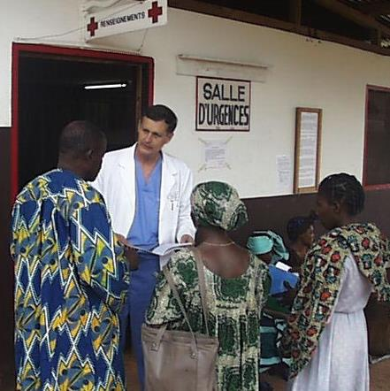
One Man Recognized the Need
Dr. David Thompson
Missionary Surgeon in Gabon

Slide 11
He Turned to God For Answers
What would happen when he left?

Slide 12
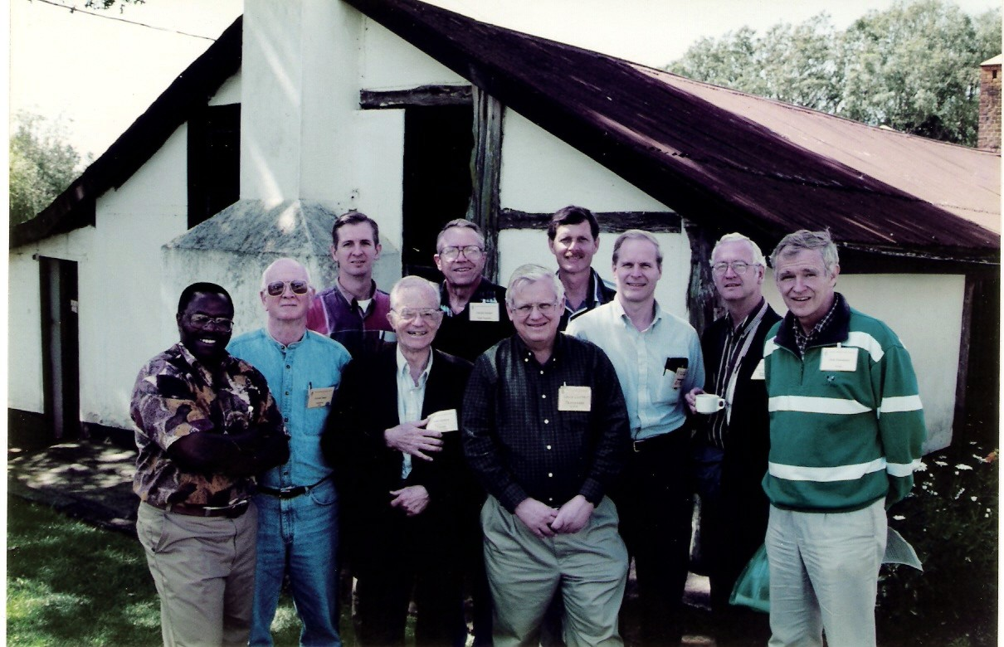
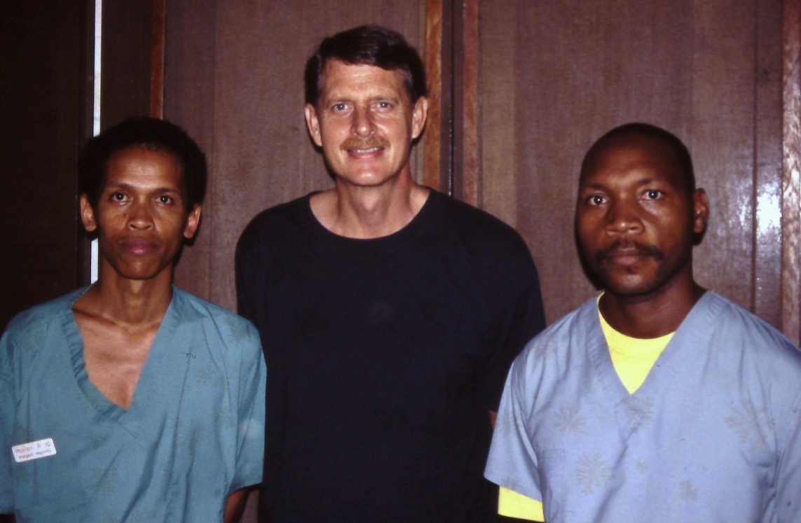
God replied,
“You train them”

Slide 13

PAACS is Sustainable Solution to Improve Lives of the Poor and Sick
By Training
Christian Surgeons and Related Specialists
IN Africa
FOR Africa

Slide 14
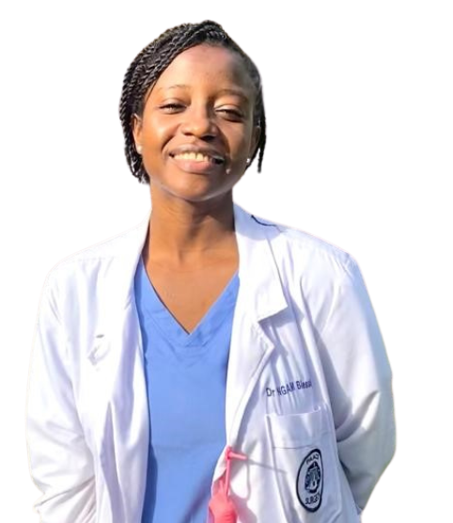
Mission Statement
PAACS’ mission is to glorify God by training and discipling African surgeons and
related specialists to become Christ-like leaders and servants providing excellent and compassionate care to those most in need.

Slide 15

Vision Statement
PAACS envisions a growing number of African surgeons and related specialists living out the Gospel and ministering to the sick.

Slide 16
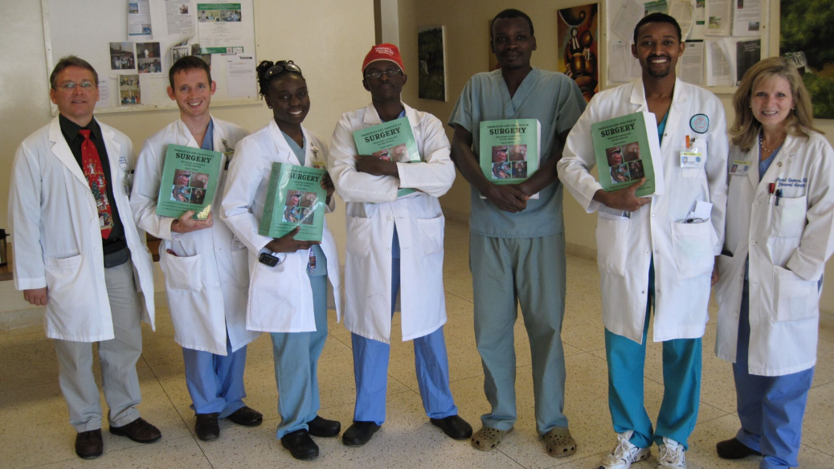
Surgical/Specialty Training
A 5-Year Training Program in
African Mission Hospitals Directed
by Experienced Board-certified Surgeons
and Related Specialists

Slide 17
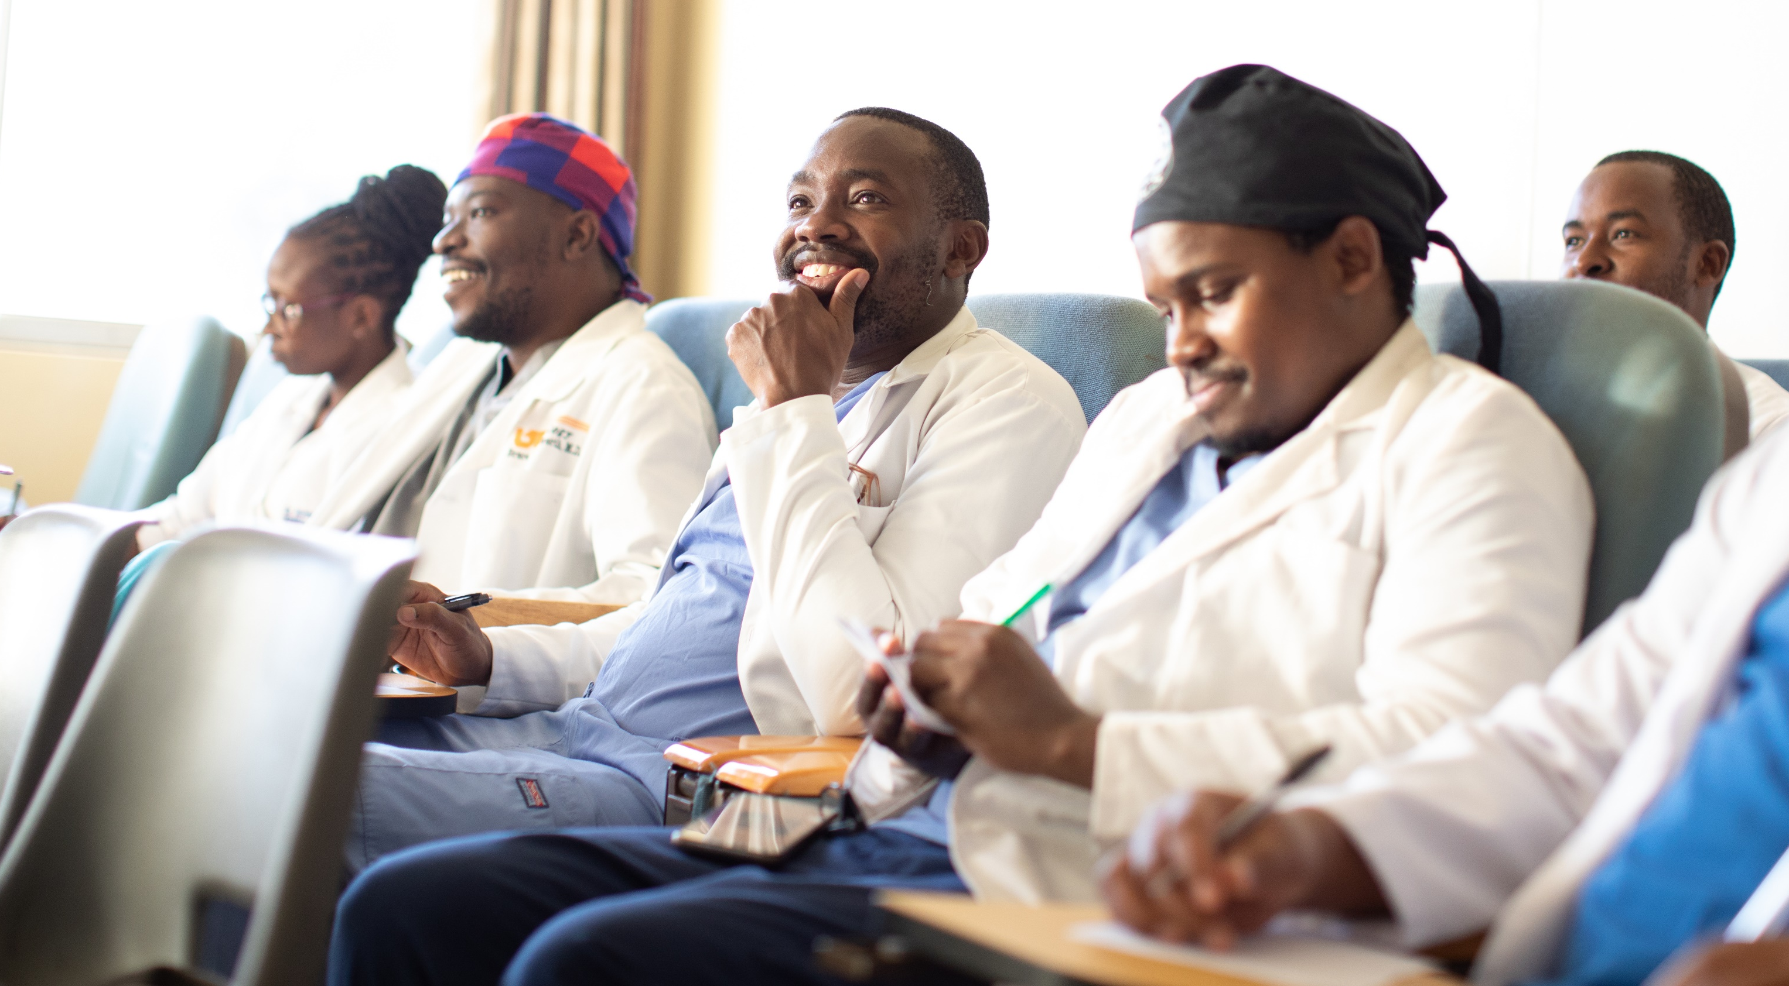
Surgical/Specialty Training
Operating Room Training
Pre- and Post-operative Care
Clinical and Academic Study
Training in Clinical Research
Yearly Exams
Hands-on
Direct Supervision

Slide 18
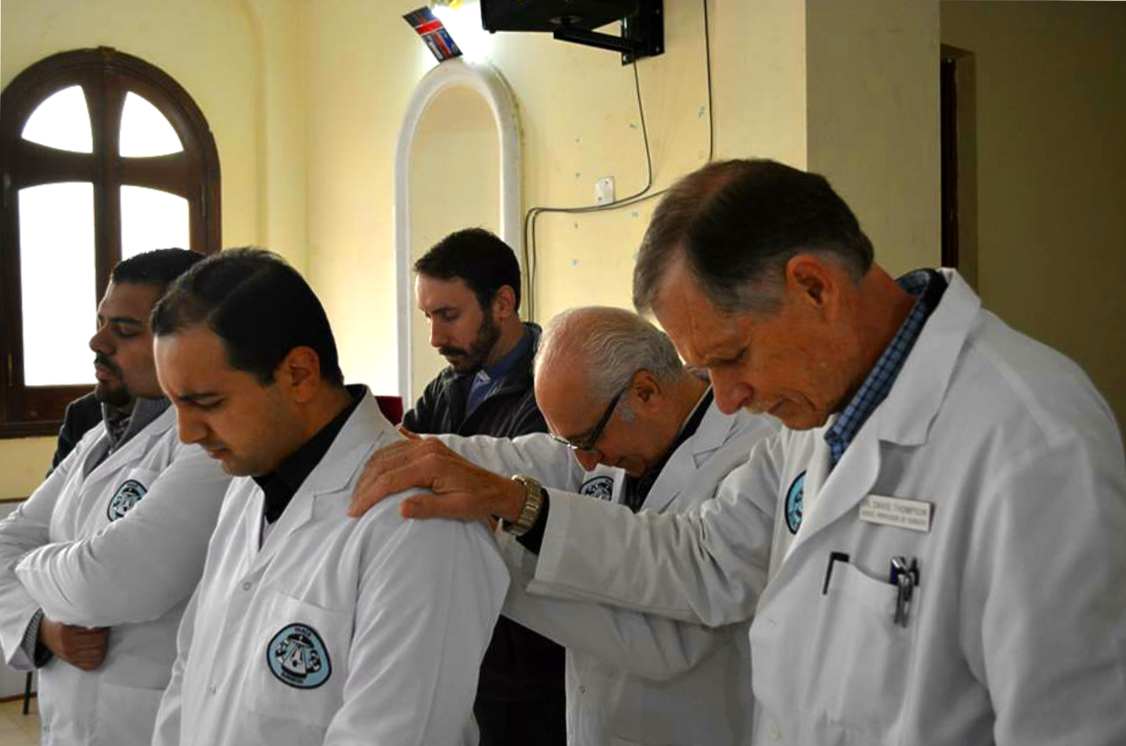
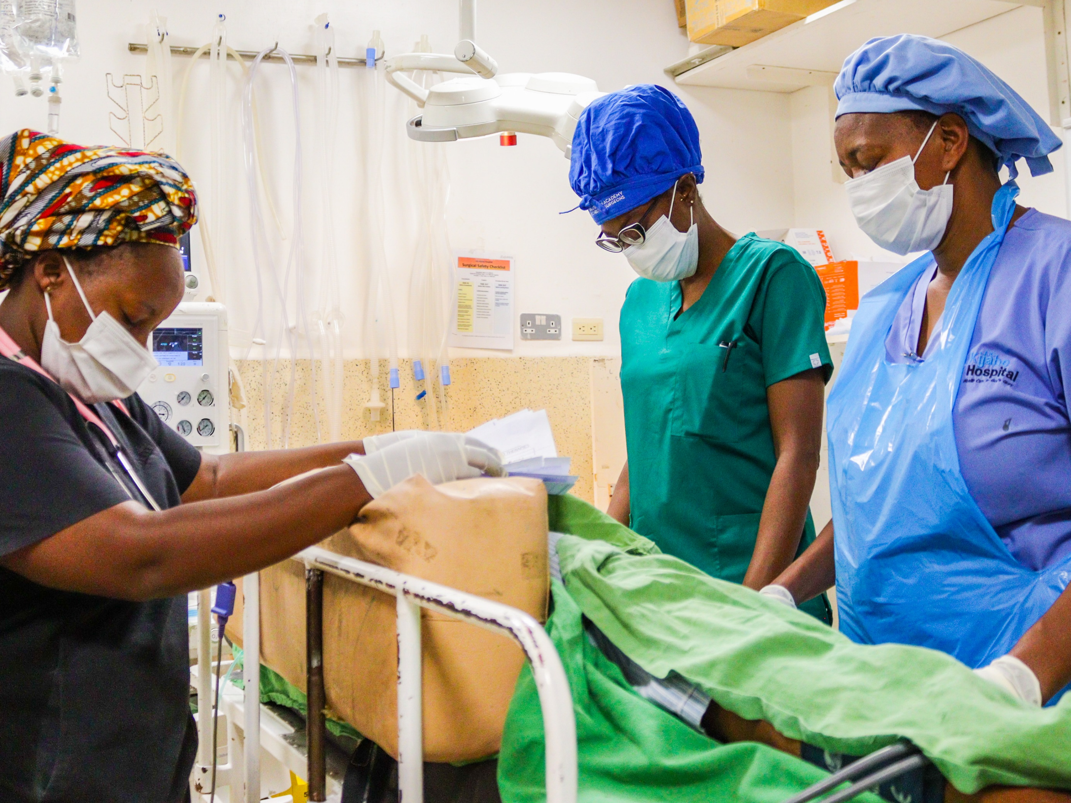

Spiritual Training
A 5-Year Spiritual Curriculum
Basic Pastoral Training
    Spiritual and Ethical Training
    Bible Study
    Taught to Share the Gospel
    Spiritual Retreats
    Spiritual Growth Assessments

Slide 19

PAACS Has Programs in 11 Countries
Burundi
Cameroon
Egypt
Ethiopia
Gabon
Kenya
Madagascar
Malawi
Niger
Tanzania
Togo

Slide 20
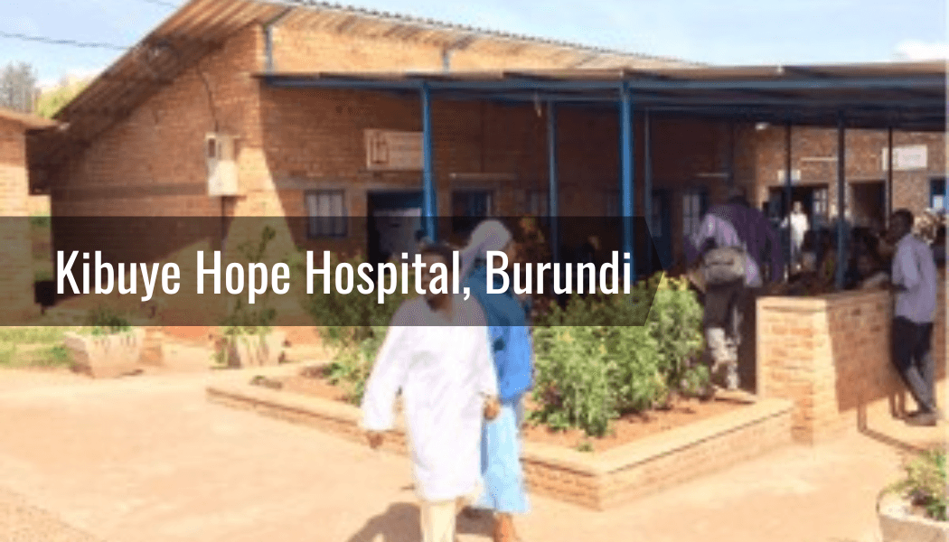






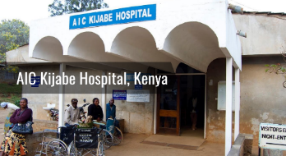









PAACS Works with
17 Mission Hospitals

Slide 21
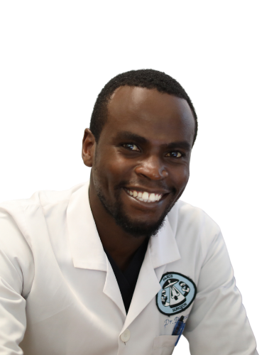
PAACS has
24 Surgical/Specialty
Training Programs
PAACS Training Programs
14 General Surgery
3 Orthopaedic Surgery
1 Pediatric Surgery
1 Cardiothoracic Surgery
1 Head and Neck Surgery
1 Neurosurgery
1 Obstetrics/Gynecology
1 Anesthesiology
1 Plastic Surgery

Slide 22

NEW PAACS General Surgery Programs
Kibuye Hope Hospital
Kibuye, Burundi
New PAACS General
Surgery Program
September 2022
Hospital of Hope
Mango, Togo
New PAACS General
Surgery Program
January 2023

Slide 23
NEW PAACS General Surgery Programs
Burundi
As one of the most surgeon-deficient countries in the world, each graduate will have a huge opportunity to create a sizable impact in their country.
Togo
The location of Hospital of Hope is in a majority Muslim community (>80%). Many patients also travel from neighboring countries including Benin, Burkina Faso, Ghana, Niger, and Nigeria.
Their combined unreached population is 104,652,000.

Slide 24
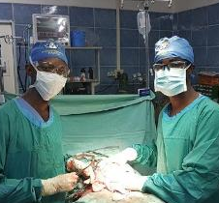
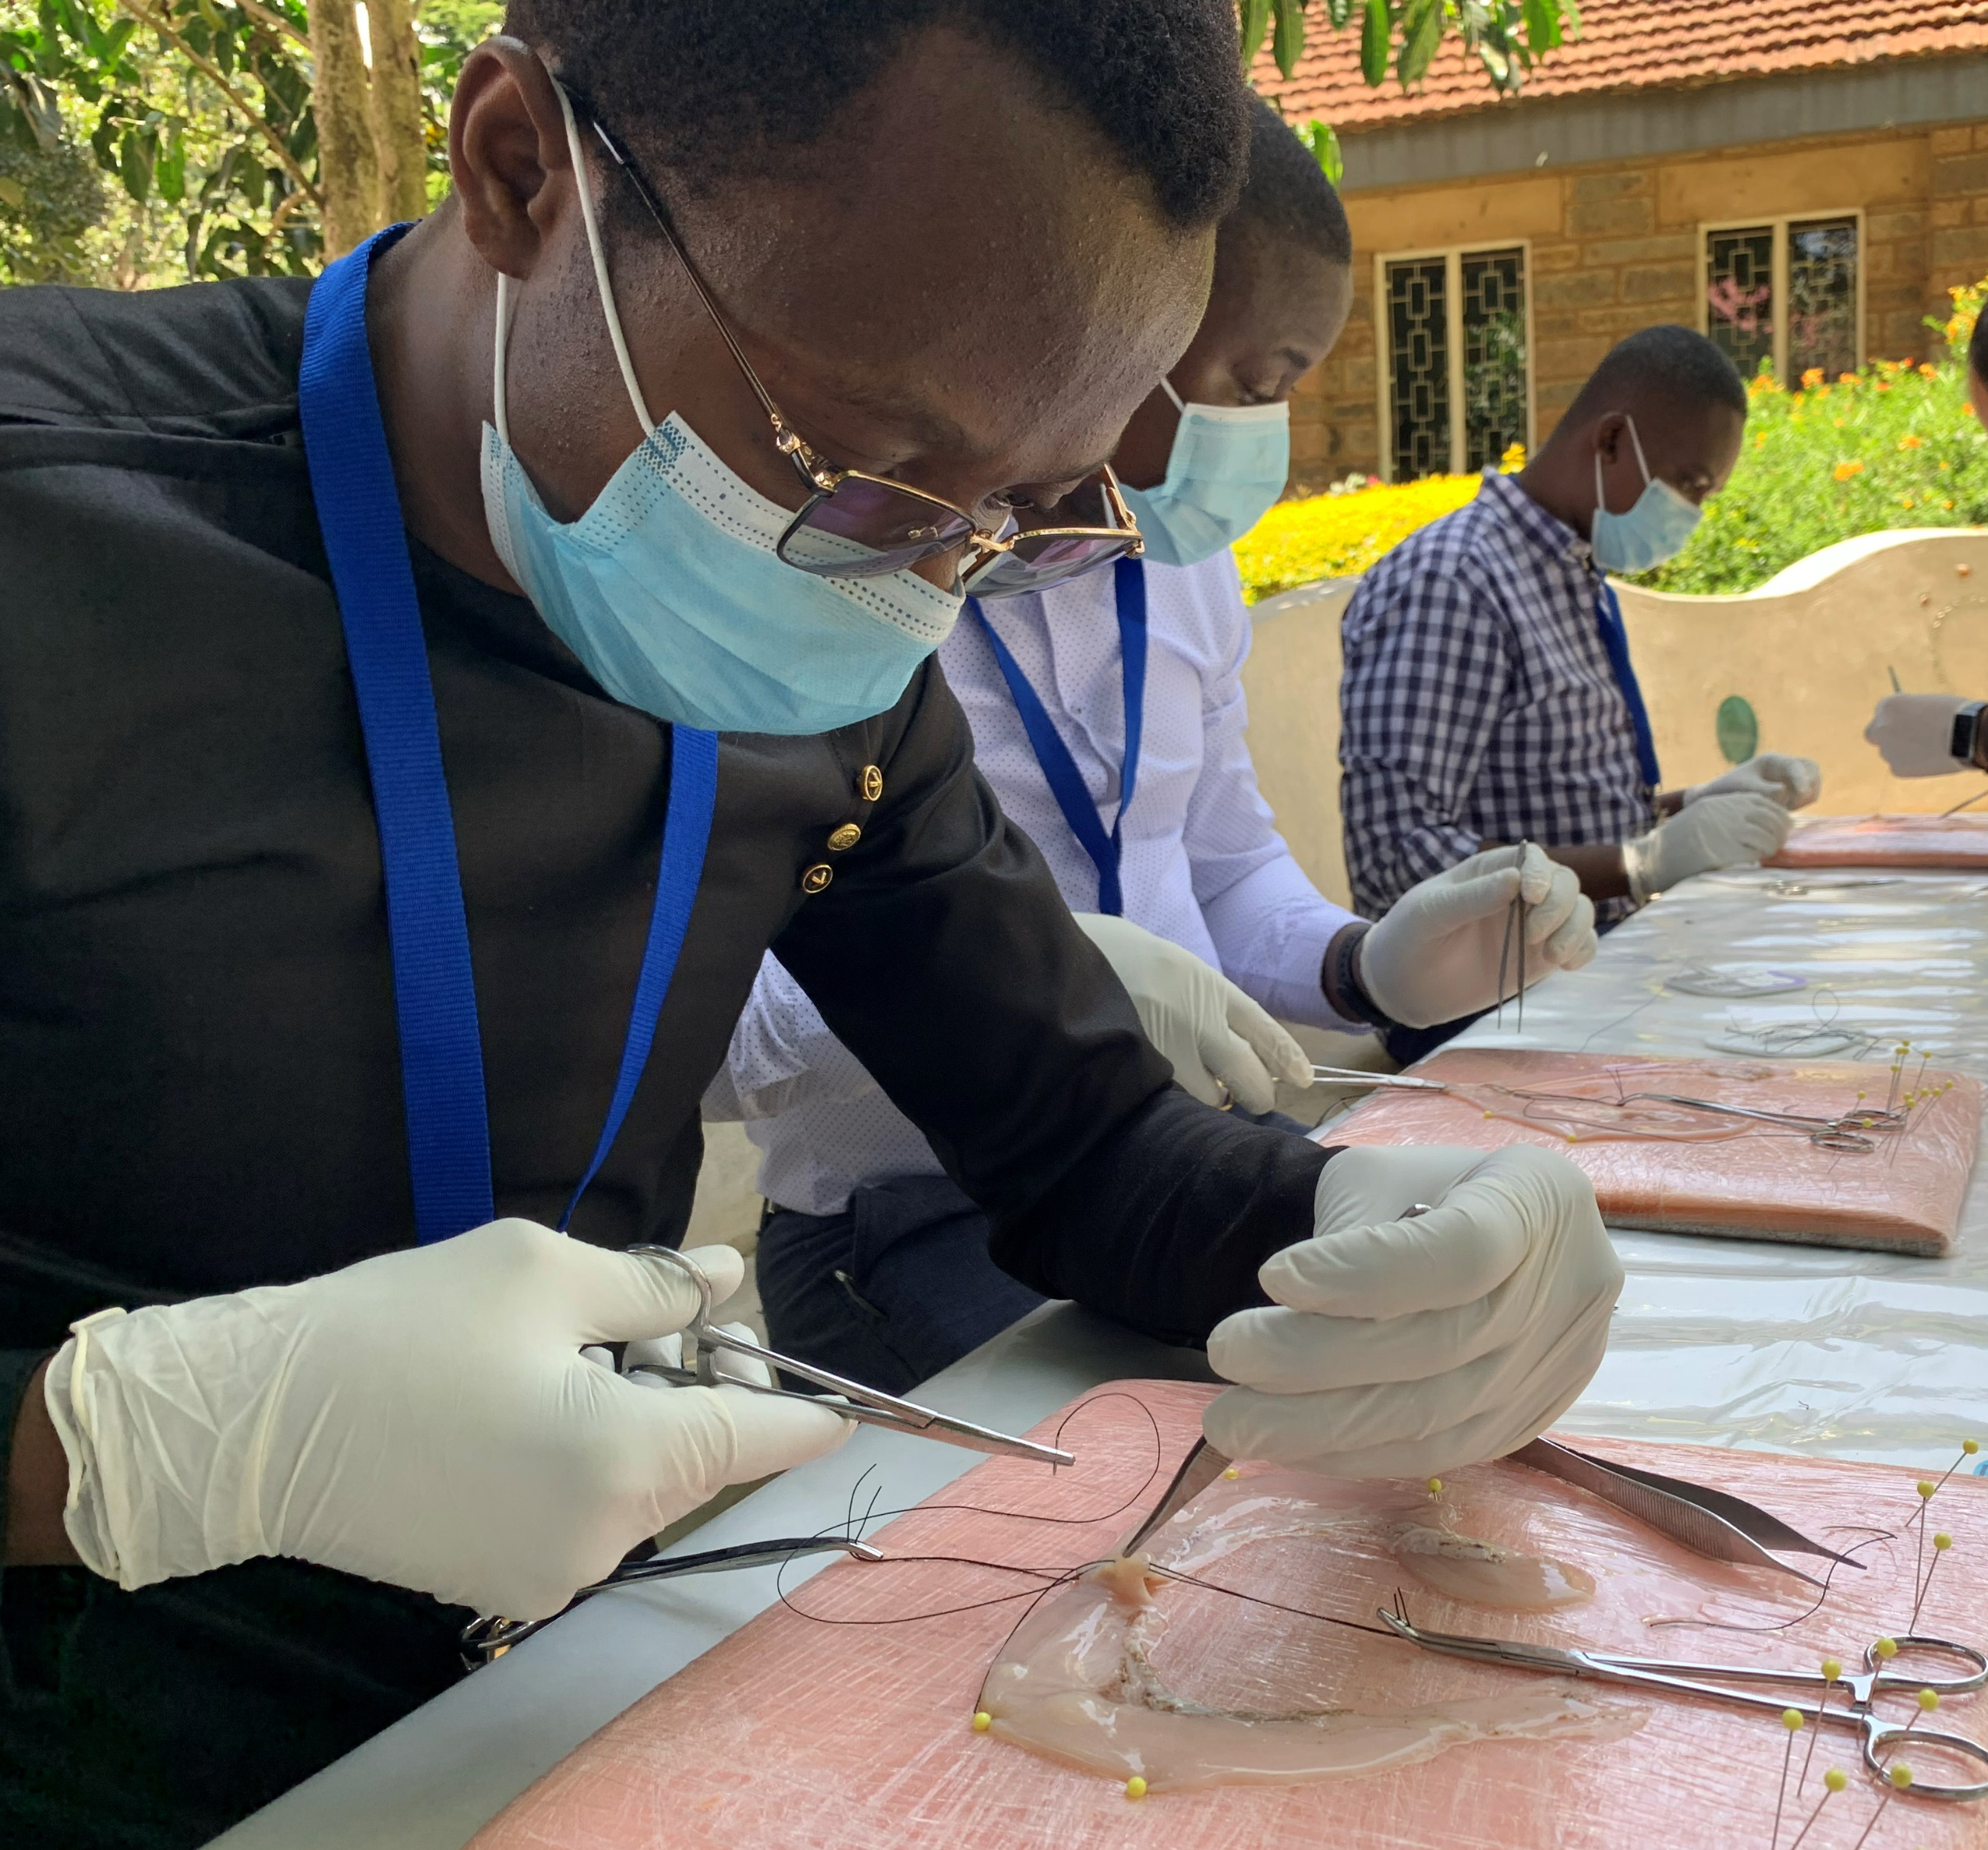
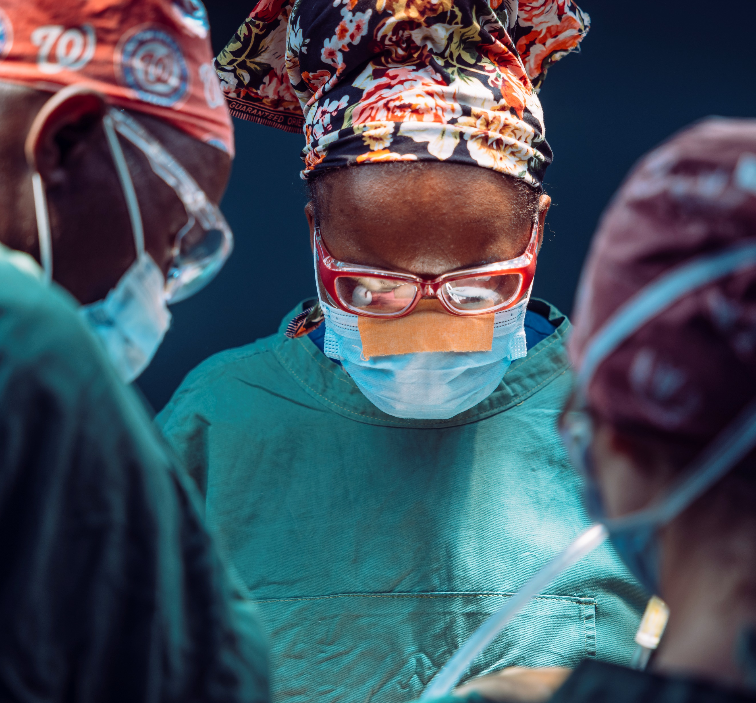
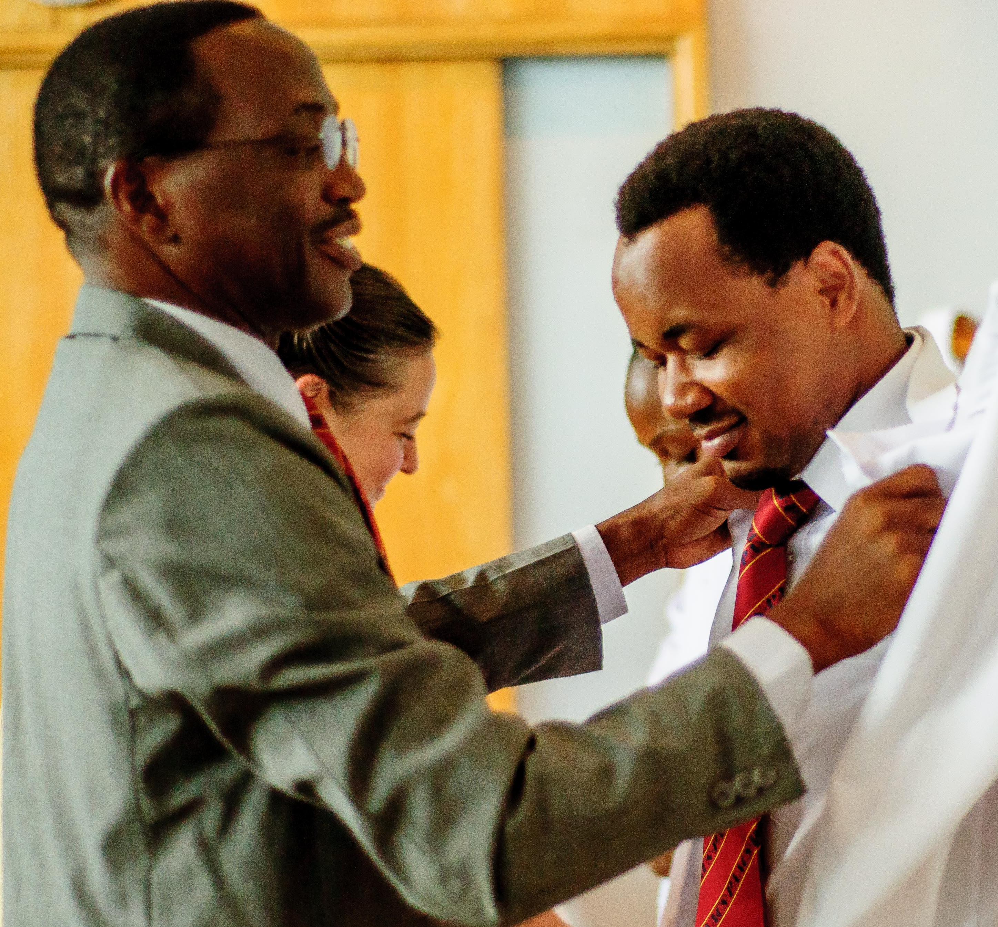
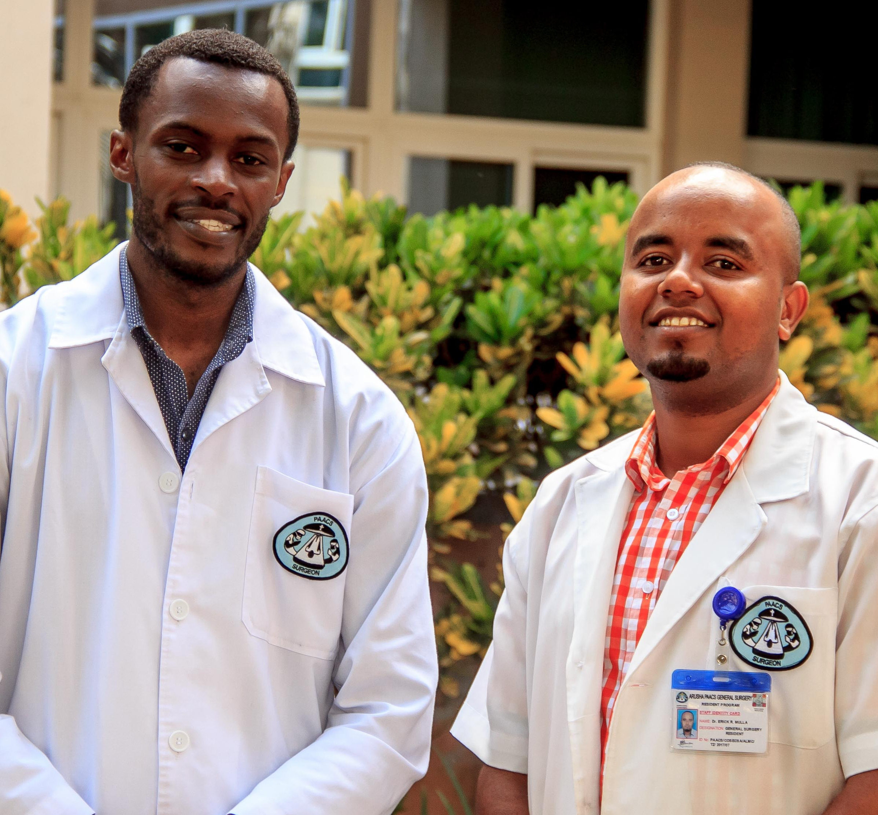
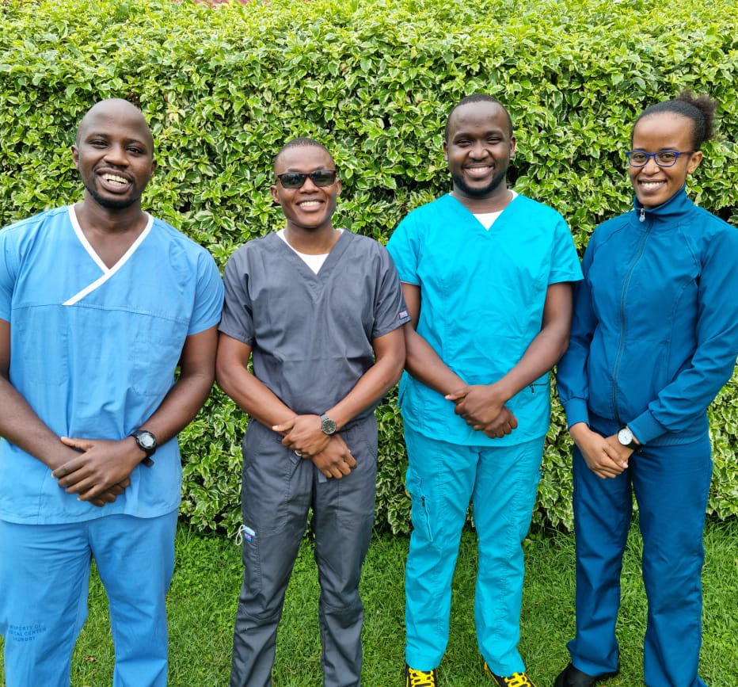
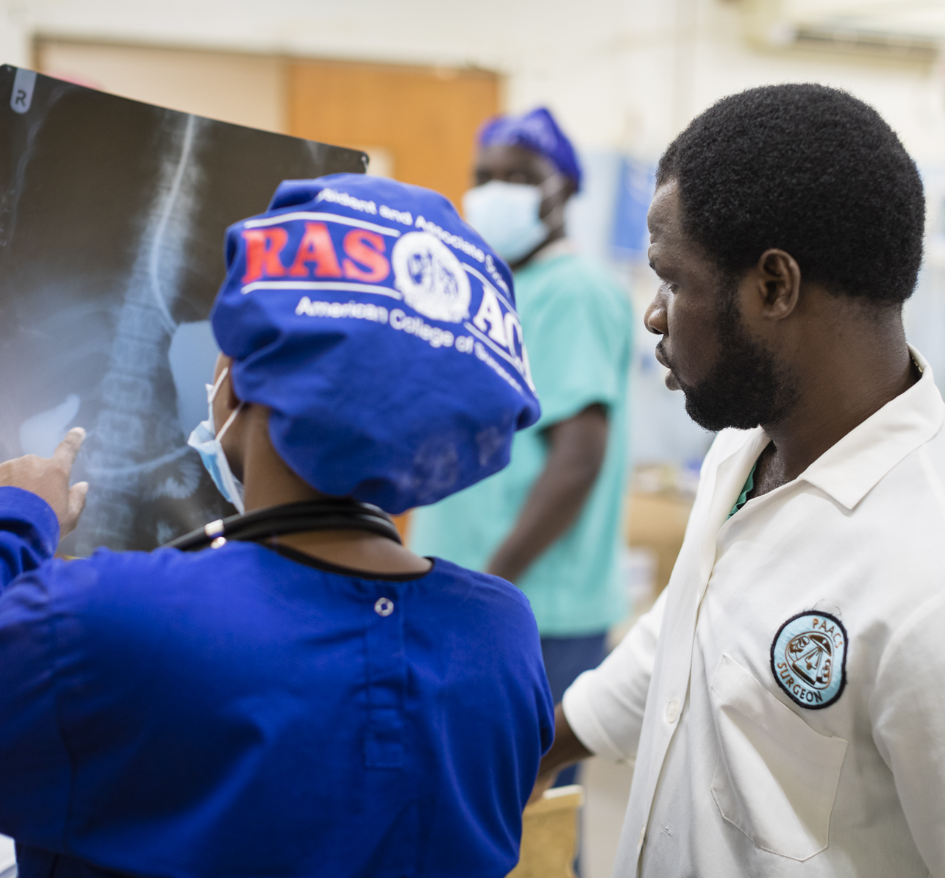
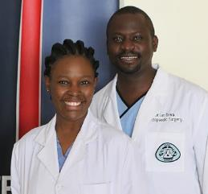
151 PAACS Residents and Fellows

Slide 25
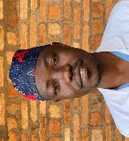
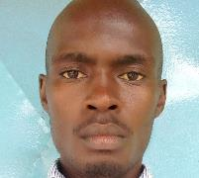
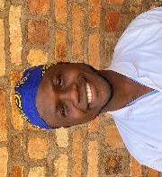
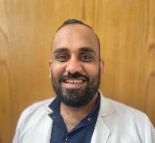
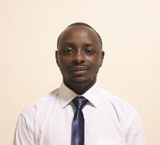
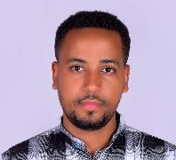
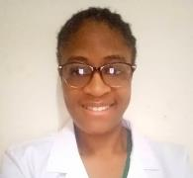
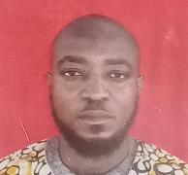
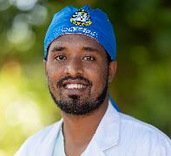
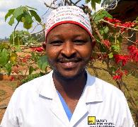

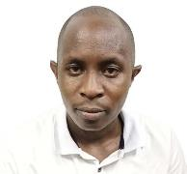
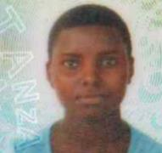
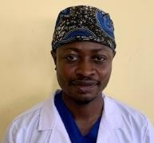
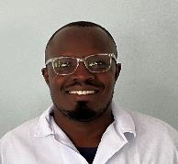
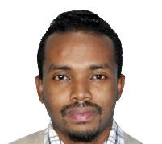
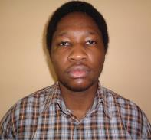
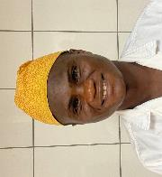
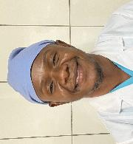
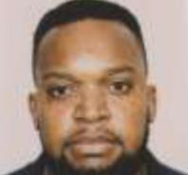
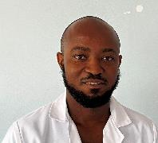
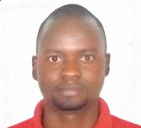
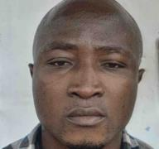
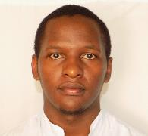
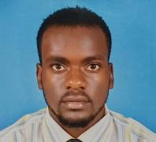
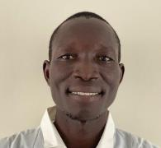














41 New Residents Started in 2023
Largest Incoming Class EVER

Slide 26

We Estimate PAACS
Residents Combined
Will Reach Between
40,000 - 45,000
Patients
This Year With Surgery

Slide 27

Over 2,100
Decisions Were Made for Christ
Through PAACS Hospitals, Faculty, Residents, and Staff

Slide 28

141 PAACS Graduates
Have Gone on to Work in
Under-Resourced Areas, Caring for the Poor of All Races and Religions

Slide 29

PAACS Graduates are Currently Serving in
21 Countries
Angola
Burundi
Cameroon
DR Congo
Egypt
Ethiopia
Gabon
Ghana
Guinea
Kenya
Lesotho
Liberia
Madagascar
Malawi
Mali
Niger
Nigeria
Rwanda
Sierra Leone
Tanzania
Zimbabwe

Slide 30



Graduate Impact in 2022
220,459
62,652
14,254
Patients Seen In Clinic
Surgeries Performed
People Heard the Good News
Estimates based on 53 responses to our 2022 PAACS Alumni Survey

Slide 31
And the things you have heard me say in the presence of many witnesses entrust to reliable people who will also be qualified to teach others.
2 Timothy 2:2

Slide 32

PAACS Faculty
110 Total Faculty Members
40 Faculty Members are PAACS Graduates

Slide 33
PAACS Graduates – Multiplication Effect
92%
of PAACS graduates are intentionally training and mentoring others to perform surgery.
65%
of PAACS graduates are discipling others in their community.

Slide 34


The World Is Taking Notice
Magazine
PAACS Graduate
Dr. Jerry Brown
Named Person of the Year Along with Other Ebola Fighters in Liberia

Slide 35
Cost to Train
PAACS
United States
$100,000/Year
5 Year Program
Over
$25,000/Year
5-Year Program
Over
$125,000 Total
$500,000 Total

Slide 36

Cost to Train
=
$9.90
per patient
$125,000 Investment
12,625 Procedures
1
PAACS Graduate
25
Year
Career
Return on Investment

Slide 37
Cost to Train
2,875
Hear the Gospel
=
$125,000 Investment
PRICELESS
1
PAACS Graduate
25
Year
Career
Return on Investment

Slide 38

Surgery extends life on earth.
This is temporary.

Slide 39

A relationship with Christ provides salvation.
This is a hope for eternity!

Slide 40


Imagine With Me
Reaching ALL Of Africa With Improved Surgical Care And The Hope Of Jesus

Slide 41


Together We Can Reach
ALL 54 Countries in Africa

Slide 42


ONE Life Changed
Surgery Restores the Physical Body
God Restores Spirit and Hope

Slide 43





Please Pray for PAACS

Slide 44



Partner With PAACS
Your Support for This Ministry
Trains AND Disciples
Necessary Surgeons and Specialists
FOR AFRICA

Slide 45

God Wants to Partner With Us for What He Wants to Accomplish Here on Earth
Men and Women Training With PAACS Have Responded:
“Here I am, Send me!”

Slide 46

THANK
YOU

